Slide 1


K.RAMAKRISHNAN COLLEGE OF TECHNOLOGY
(AUTONOMOUS), TRICHY.
DEPARTMENT OF
COMPUTER SCIENCE AND ENGINEERING
20CS5501 DESIGN PROJECT-1
Batch No : 3
Date : 06.12.2024

Slide 2
BIKE SPOT
Guided by Team
Mrs.K.Valli priyadharshini M.E.,(ph.D)., Kabilan P (811722104066) Logeshwaran P (811722104083)
Nachiappan PL (811722104097)

Slide 3
OBJECTIVE OF THE PROJECT
The objective of the "BIKE SPOT" project is to design an effective management system for repair and servicing bikes at various key locations.
The system should be user-friendly, allowing customers to easily access bike rental services, bike-repair mechanical services, and provide feedback.
The goal is to enhance the convenience of repair, finishing time, and servicing bikes, while also enabling tracking of customer satisfaction and feedback, rating.

Slide 4
ABSTRACT
Bike Spot Service is an innovative project designed to provide cyclists with easy access to a list of bike repair shops and service centers. This platform offers detailed information about each service center, including the place (Address), phone number, starting price for various services, and finishing hours of operation. Users can search for bike repair shops based on proximity and service offerings, making it an essential tool for anyone looking to maintain or repair their bike. The directory is built to be user-friendly, allowing users to navigate through a clear, simple interface. It includes features like a place, phone number, starting price, and finishing hours of use for people of all technical upfront. Starting prices for common repairs, giving users a transparent idea of costs upfront. Additionally, each bike service center provides its hours of operation, including special timings on weeks to ensure users can plan their visits accordingly. This makes the Bike Spot Service a reliable and practical tool for bike in need of repairs, whether they are experienced riders or casual users.

Slide 5
LITERATURE SURVEY
TITLE OF THE PAPER | AUTHOR (S) | PUBLISHER | PAPER GIST | TECHNOLOGY USED
Opitimization of urban bike service spot allocation for enhanced accessibility and maintenance efficient. | Arun mehta, Priya sharma, Mr. Rajat singh | Service allocation for urban bike centre(2023) | geospatial analysis, demand forecasting, and stakeholder surveys to optimize urban bike service. | statistical modeling tools, and survey analysis platforms
Overcoming Barriers to E-Commerce Adoption for Small Businesses. | Er. Shrinidhi Gindi | E-Commerce Research and Applications(2022) | Identifies practical barriers and solutions, relevant for small business owners. | Collaborative Filtering
The Role of Recommendation Systems in Enhancing E-Commerce Experience. | Gaus shaikh | International Journal of Online Marketing(2021) | Comprehensive review of recommendation systems, practical implications for e-commerce. | Content-based Filtering.

Slide 6
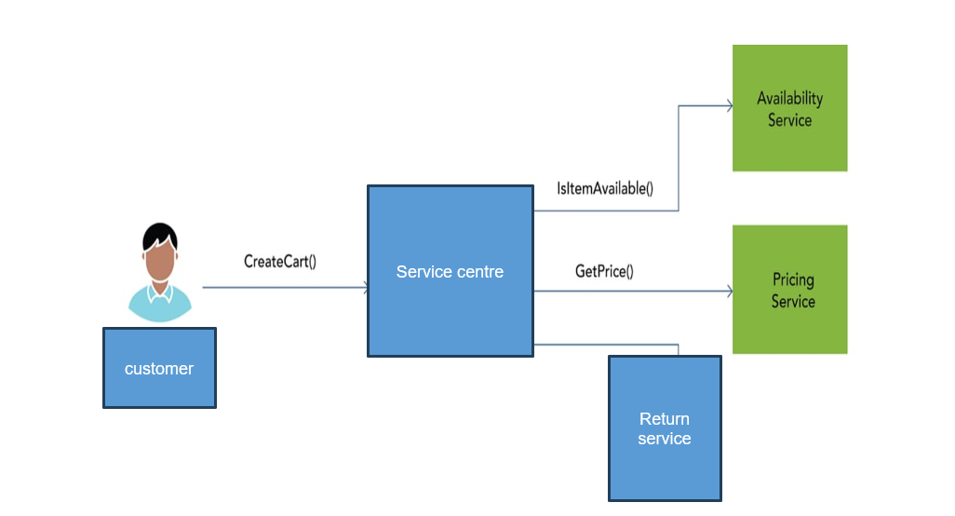
PROPOSED SYSTEM ARCHITECTURE
service()
Details
Price()
Finish()
Finishing time

Slide 7
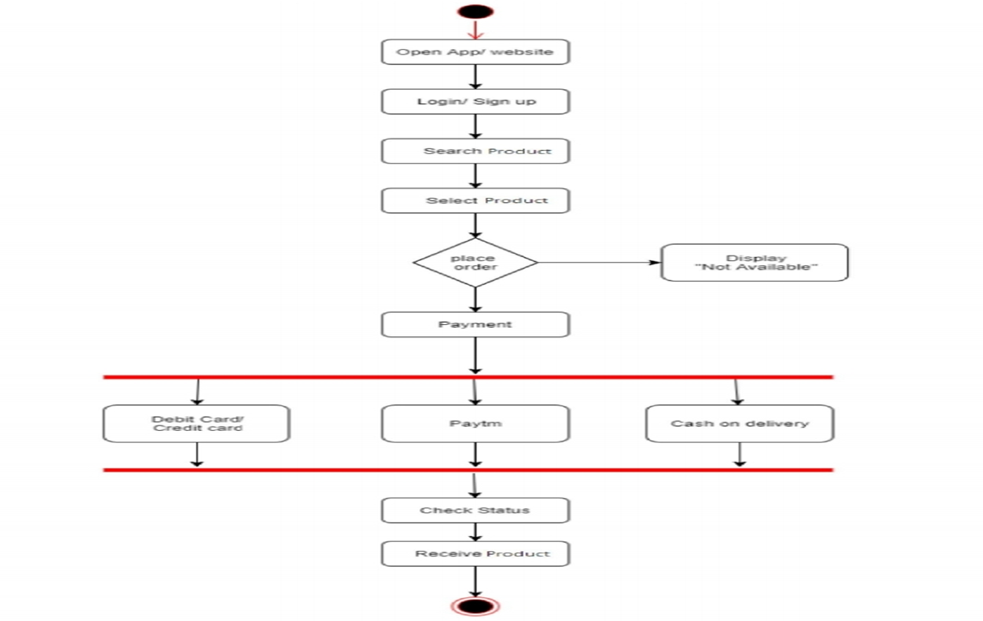
EXISTING SYSTEM ARCHITECTURE
Open website
Login
Service details
Select shop
convenience
Not con
View details
Verify location 1
Verify location 2
Verify location 3
Confirm location
Refresh

Slide 8
SOFTWARE AND HARDWARE REQUIREMENTS
HARDWARE
SOFTWARE
Ram: 4.00 GB
Processor: Intel(R) Pentium(R) 2.11 GHz
Hard Disk: 520 GB
Operating System: Windows
Software: VS Code
Language: Html, CSS, React

Slide 9
MODULES
LOGIN
LOCATION
SERVICE DETAILS
DATA COLLECTION

Slide 10
SUMMARY OF MODULE-1
LOGIN
First user must login the web page. These modules manage the logic of user authentication, password management, and sessions.
Login Management: User data (email, password and Invalid email and password.).
Authentication:Validate user credentials during login.Ensure passwords are hashed and stored securely.
Session Management: Create and maintain user sessions (using Html, CSS and react, or session-based authentication).

Slide 11
SUMMARY OF MODULE-2
LOCATION
Location-based Filtering Location Services: Uses the user's current location to suggest nearby places.Proximity Search: Suggests locations within a certain radius from the user’s current or inputted location.
Recommendation Engines Collaborative Filtering: Recommends locations based on the preferences and behaviors of similar users And Content-based Filtering.
Suggests locations based on the attributes of places that match the user’s preferences (e.g., type of tourist, Bikers attraction).

Slide 12
SUMMARY OF MODULE-3
SERVICE DETAILS
The Bike Spot Service Center is an innovative platform designed to make it easier for Bikers to find and access reliable bike repair shops and service centers. This service provides detailed information on each shop, including:
Place : The exact address to help users locate the service center.
Phone Number : Direct contact information for scheduling or inquiries.
Starting Prices : Transparent initial pricing for common services so users can plan their budget ahead.
Hours of Operation : Standard hours as well as any special hours for finishing one day or few house to ensure users can visit at the right time.

Slide 13
SUMMARY OF MODULE-4
DATA COLLECTION
1. Purpose: To optimize service efficiency, improve customer satisfaction, and ensure operational transparency by collecting data on locations, services, and feedback.
2. Implementation: Data is collected from front (location-based) and back (service details) sides, including shop info, service times, fees, and customer feedback.
3. Storage: Data is securely stored in cloud databases with manual backups, ensuring privacy, security, and easy access for analysis and improvements

Slide 14
RESULTS AND DISCUSSION
Bike Spot Service Center is a user-focused platform designed to help Bikers easily find bike repair shops and service centers. It offers detailed information such as location, phone number, starting prices for services, and hours of operation, allowing users to plan visits effectively. The platform’s simple and intuitive interface makes it accessible to cyclists of all technical levels. By listing starting prices and special hours, it ensures users can budget and schedule repairs efficiently.
In discussions surrounding its effectiveness, the Bike Spot Service Center stands out as a reliable tool due to its comprehensive data and ease of use. It successfully meets the need for a practical and user-focused service, empowering cyclists to maintain their bikes in a way that saves time and effort. The platform's search functionality, which allows users to filter service centers based on proximity and specific services offered, enhances its utility further, making it a must-have resource for anyone looking to ensure their bike is well-maintained and in good working order.

Slide 15
CONCLUSION
This setup allows for a efficient bike service experience, catering to both locals and travelers. With well-placed spots at prime locations and clear service information, users can easily access necessary services and give feedback, improving overall customer satisfaction.
The implementation of a well-structured Bike Spot service system at strategic bike shop in Trichy will significantly improve convenience and accessibility for commuters and customer be like.

Slide 16
THANK YOU

